Slide 1


Health Care Data Management System
Presenting By 1. Devi Sowjanya Padala
2. Jeevitha Bandi
3. Naveen Pasupula

Slide 2
Introduction
The main goal of this Health Care Data Management System project is
To leverage data management techniques to create an efficient and reliable platform for managing patient records, appointments, and medical histories.
By integrating data from hospital systems, electronic health records (EHR), and patient feedback, the system aims to streamline administrative workflows, enhance patient care, and support data-driven decision-making.

Slide 3
Primary Objectives
Efficient Patient Record Management
Optimized Appointments scheduling
Employee Performance Monitoring
Data - Driven Medical Insights
Challenges Addressed
Fragmented patient records
Inefficient scheduling
High Operational Costs

Slide 4
Data Pipeline
Data Source
Data Storage
Data Transformation

Slide 5
Data Source
Data Storage
Created mock data using MOCKAROO.
- 1000 patient records were created
Stored in structured relational database.
Generated data captures key aspects of health care management system.
Schema consists of multiple interconnected tables.
The data captures
Patient & Employee Demographic Information
Appointment details
Billing Information
Diagnostic Information
Ratings and Feedback

Slide 6
Entities
Patient
Appointments
Employee
Stores details of patients, including (Name, Age, Gender, Weight, etc.)
Stores appointment details, along with the assigned doctor and visit date.
Contains details of hospital employees, including their roles, departments.
Department
Role
Patient_Register
Contains departments within the hospital, such as Emergency, Cardiology, etc
Contains different roles within the hospital, such as Doctor, Nurse, Lab Technician, etc.
Tracks patient visits, including details such as Admitted On, Discharged, etc.
Feedback
Disease
LabTest
Address
Contains a list of medical tests available at the hospital, such as Blood Tests, MRI, etc.
Stores address details for patients and employees.
Stores ratings and reviews given by patients for employees during their visit
Maintains a catalog of diseases, including their name, description, etc.

Slide 7
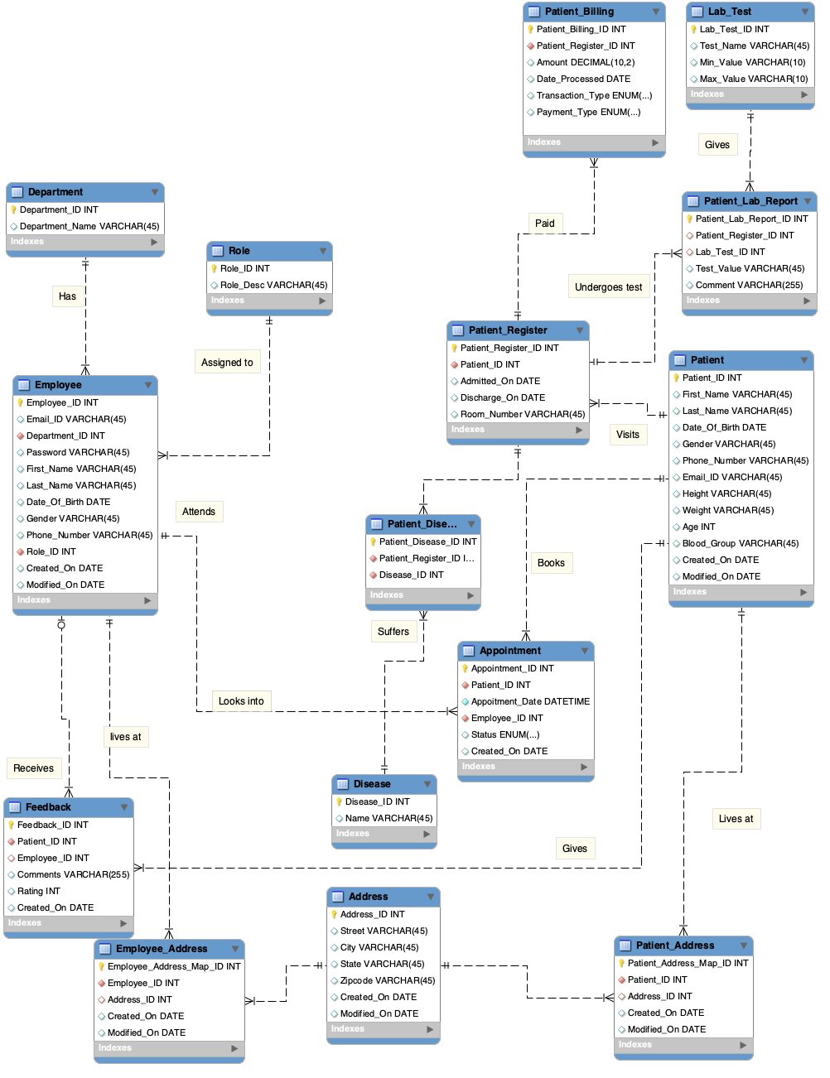
Data Model
Shows how various entities (tables) are structured, related.
Relationships (1:M, M:N)

Slide 8
Data Transformation
Standardizing date time formats & numerical values.
- Ensuring all date times follow a consistent format.
- Height, Weight, Age and other numerical values should be realistic.
Eliminating duplicate entries.
- Ensuring one appointment per patient per time slot.
- Preventing duplicate feedback entries for a single visit to maintain accuracy.
Ensuring logical consistency in patient records.
- Ensuring no inconsistencies in hospital stay durations.
Classifying patients into Age Groups.
- Patients are categorized based on Age to enable demographic based analysis.

Slide 9
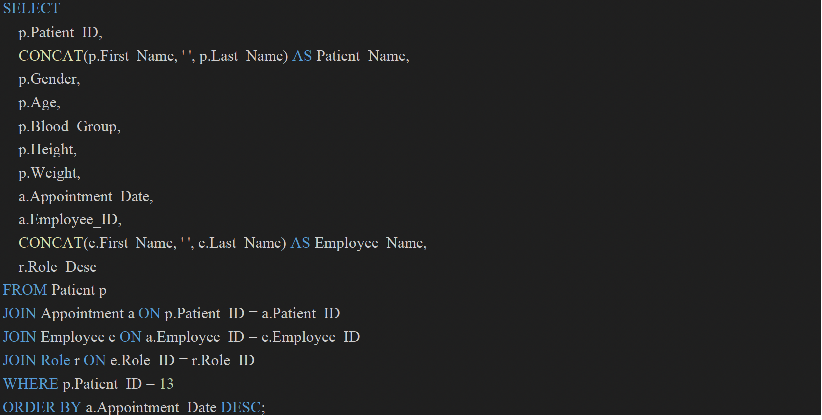
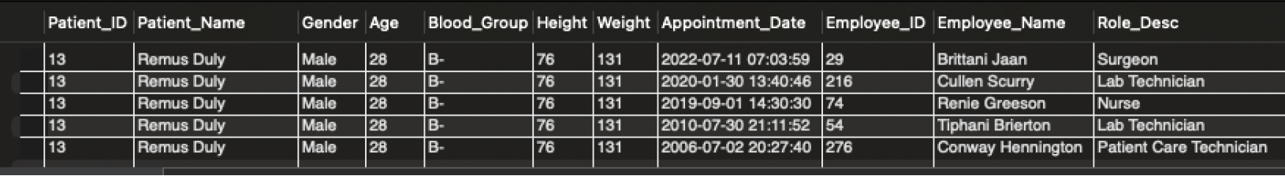
Query Execution & Analytics
Query1: Patient History
Result

Slide 10
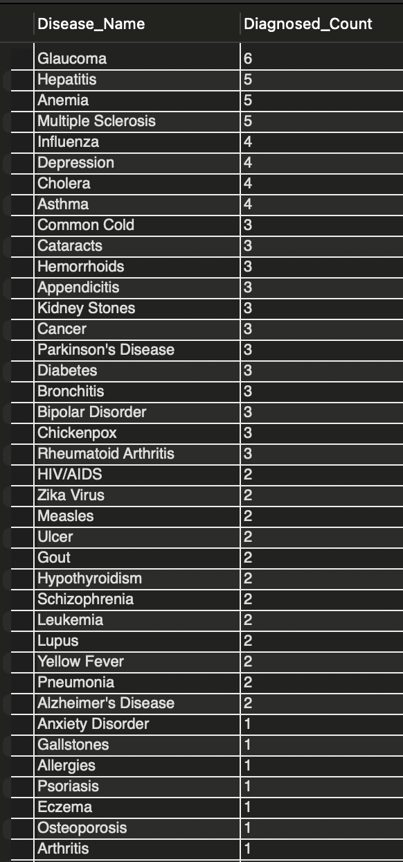
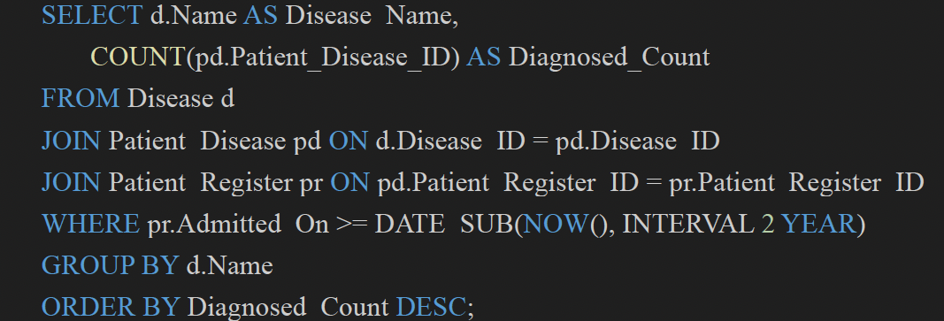
Result
Query2: Most diagnosed diseases in the last 2 years

Slide 11
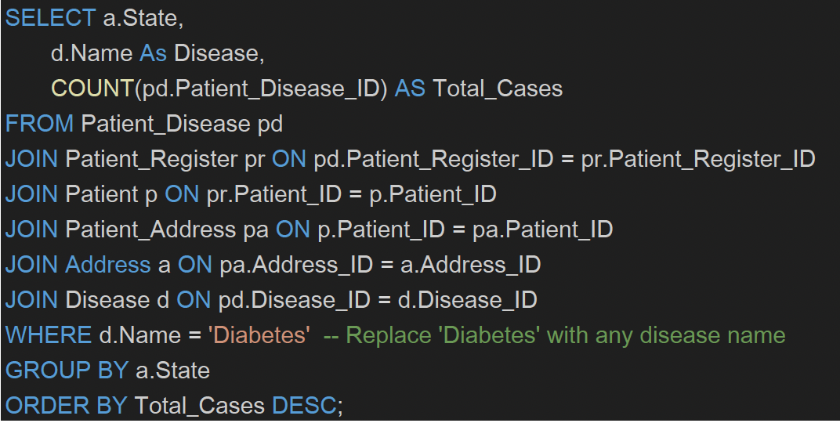
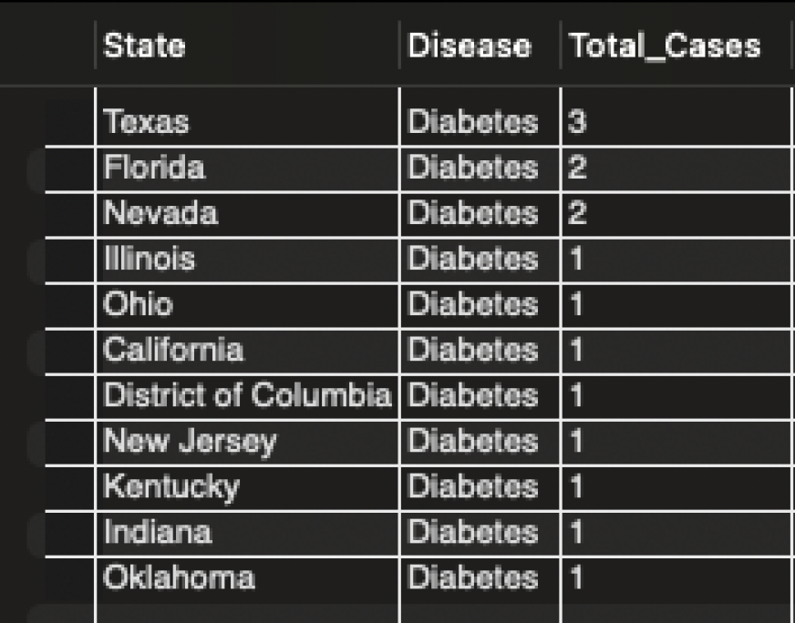
Query3:State wise cases recorded for a disease
Result

Slide 12
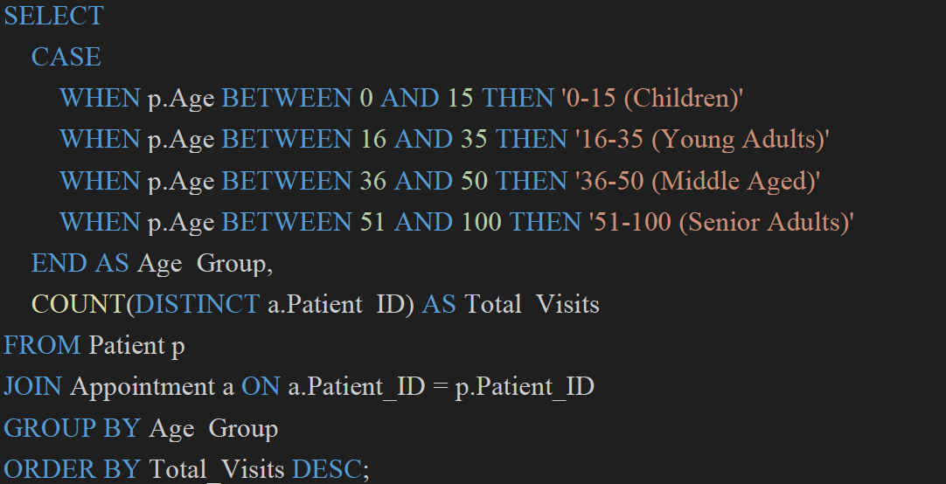
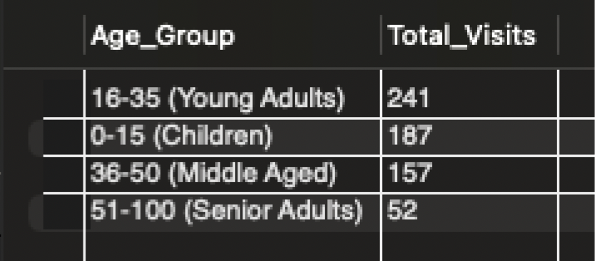
Query3: Patient visits by age group
Result

Slide 13
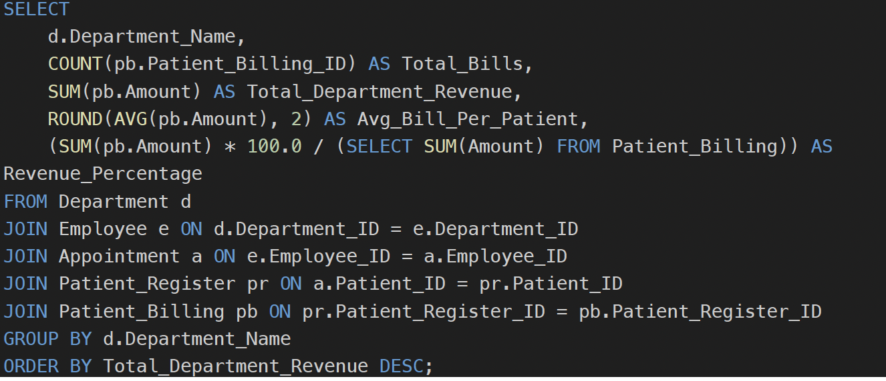
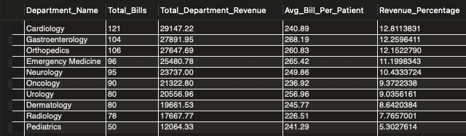
Query5: Revenue generated by each department
Result

Slide 14
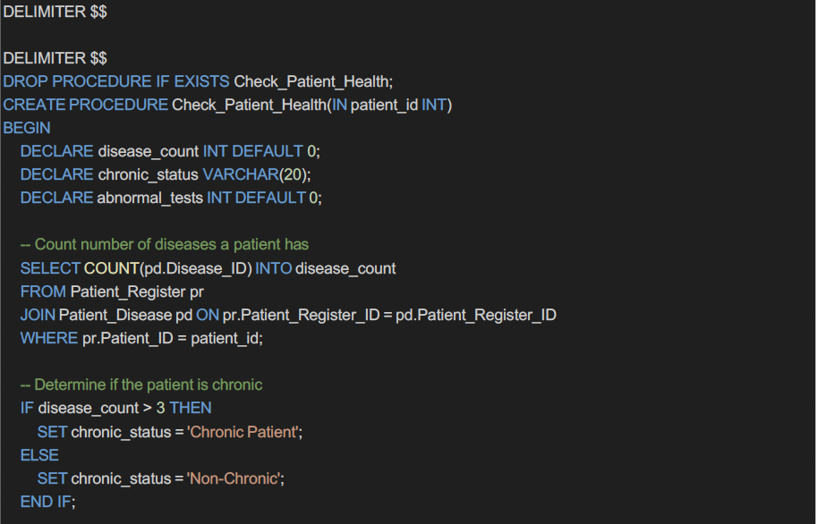
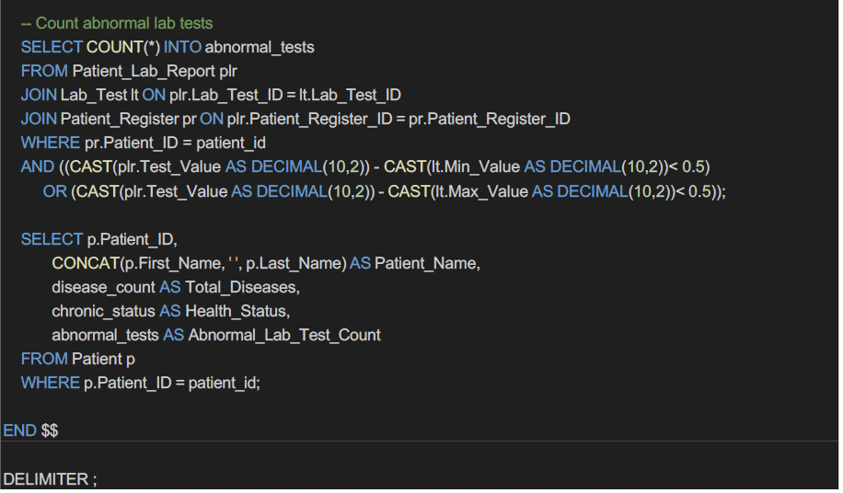
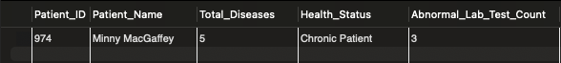
Stored Procedures
Stored Procedure1: Analyze patient diseases and abnormal lab test results.
Result

Slide 15
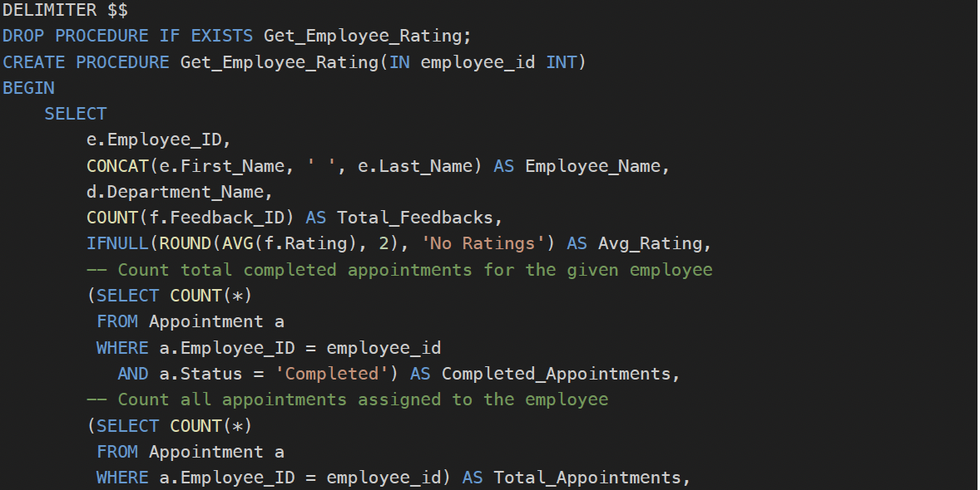
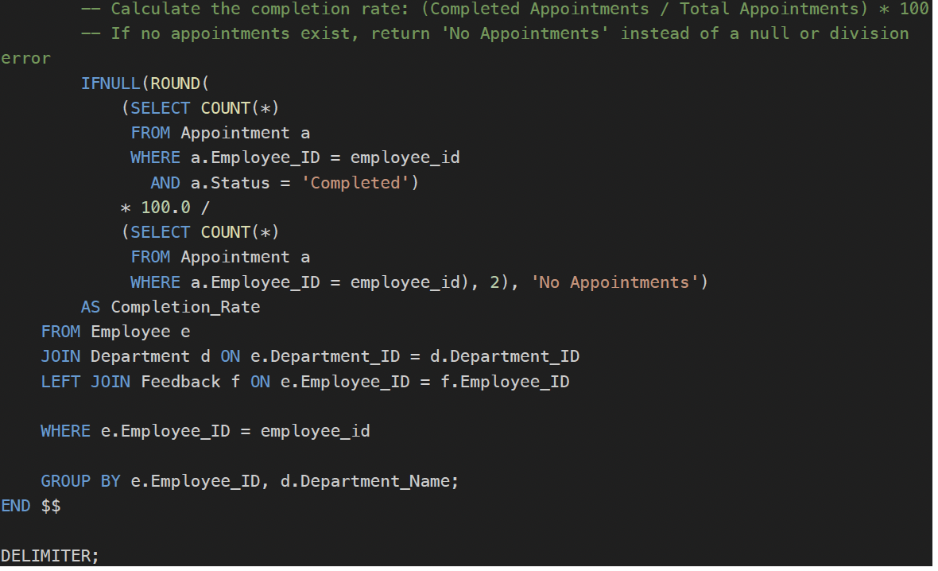
Stored Procedures
Stored Procedure2: Retrieve employee rating and performance insights.
Result

Slide 16

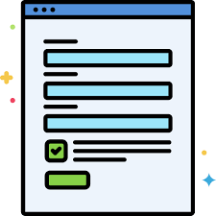
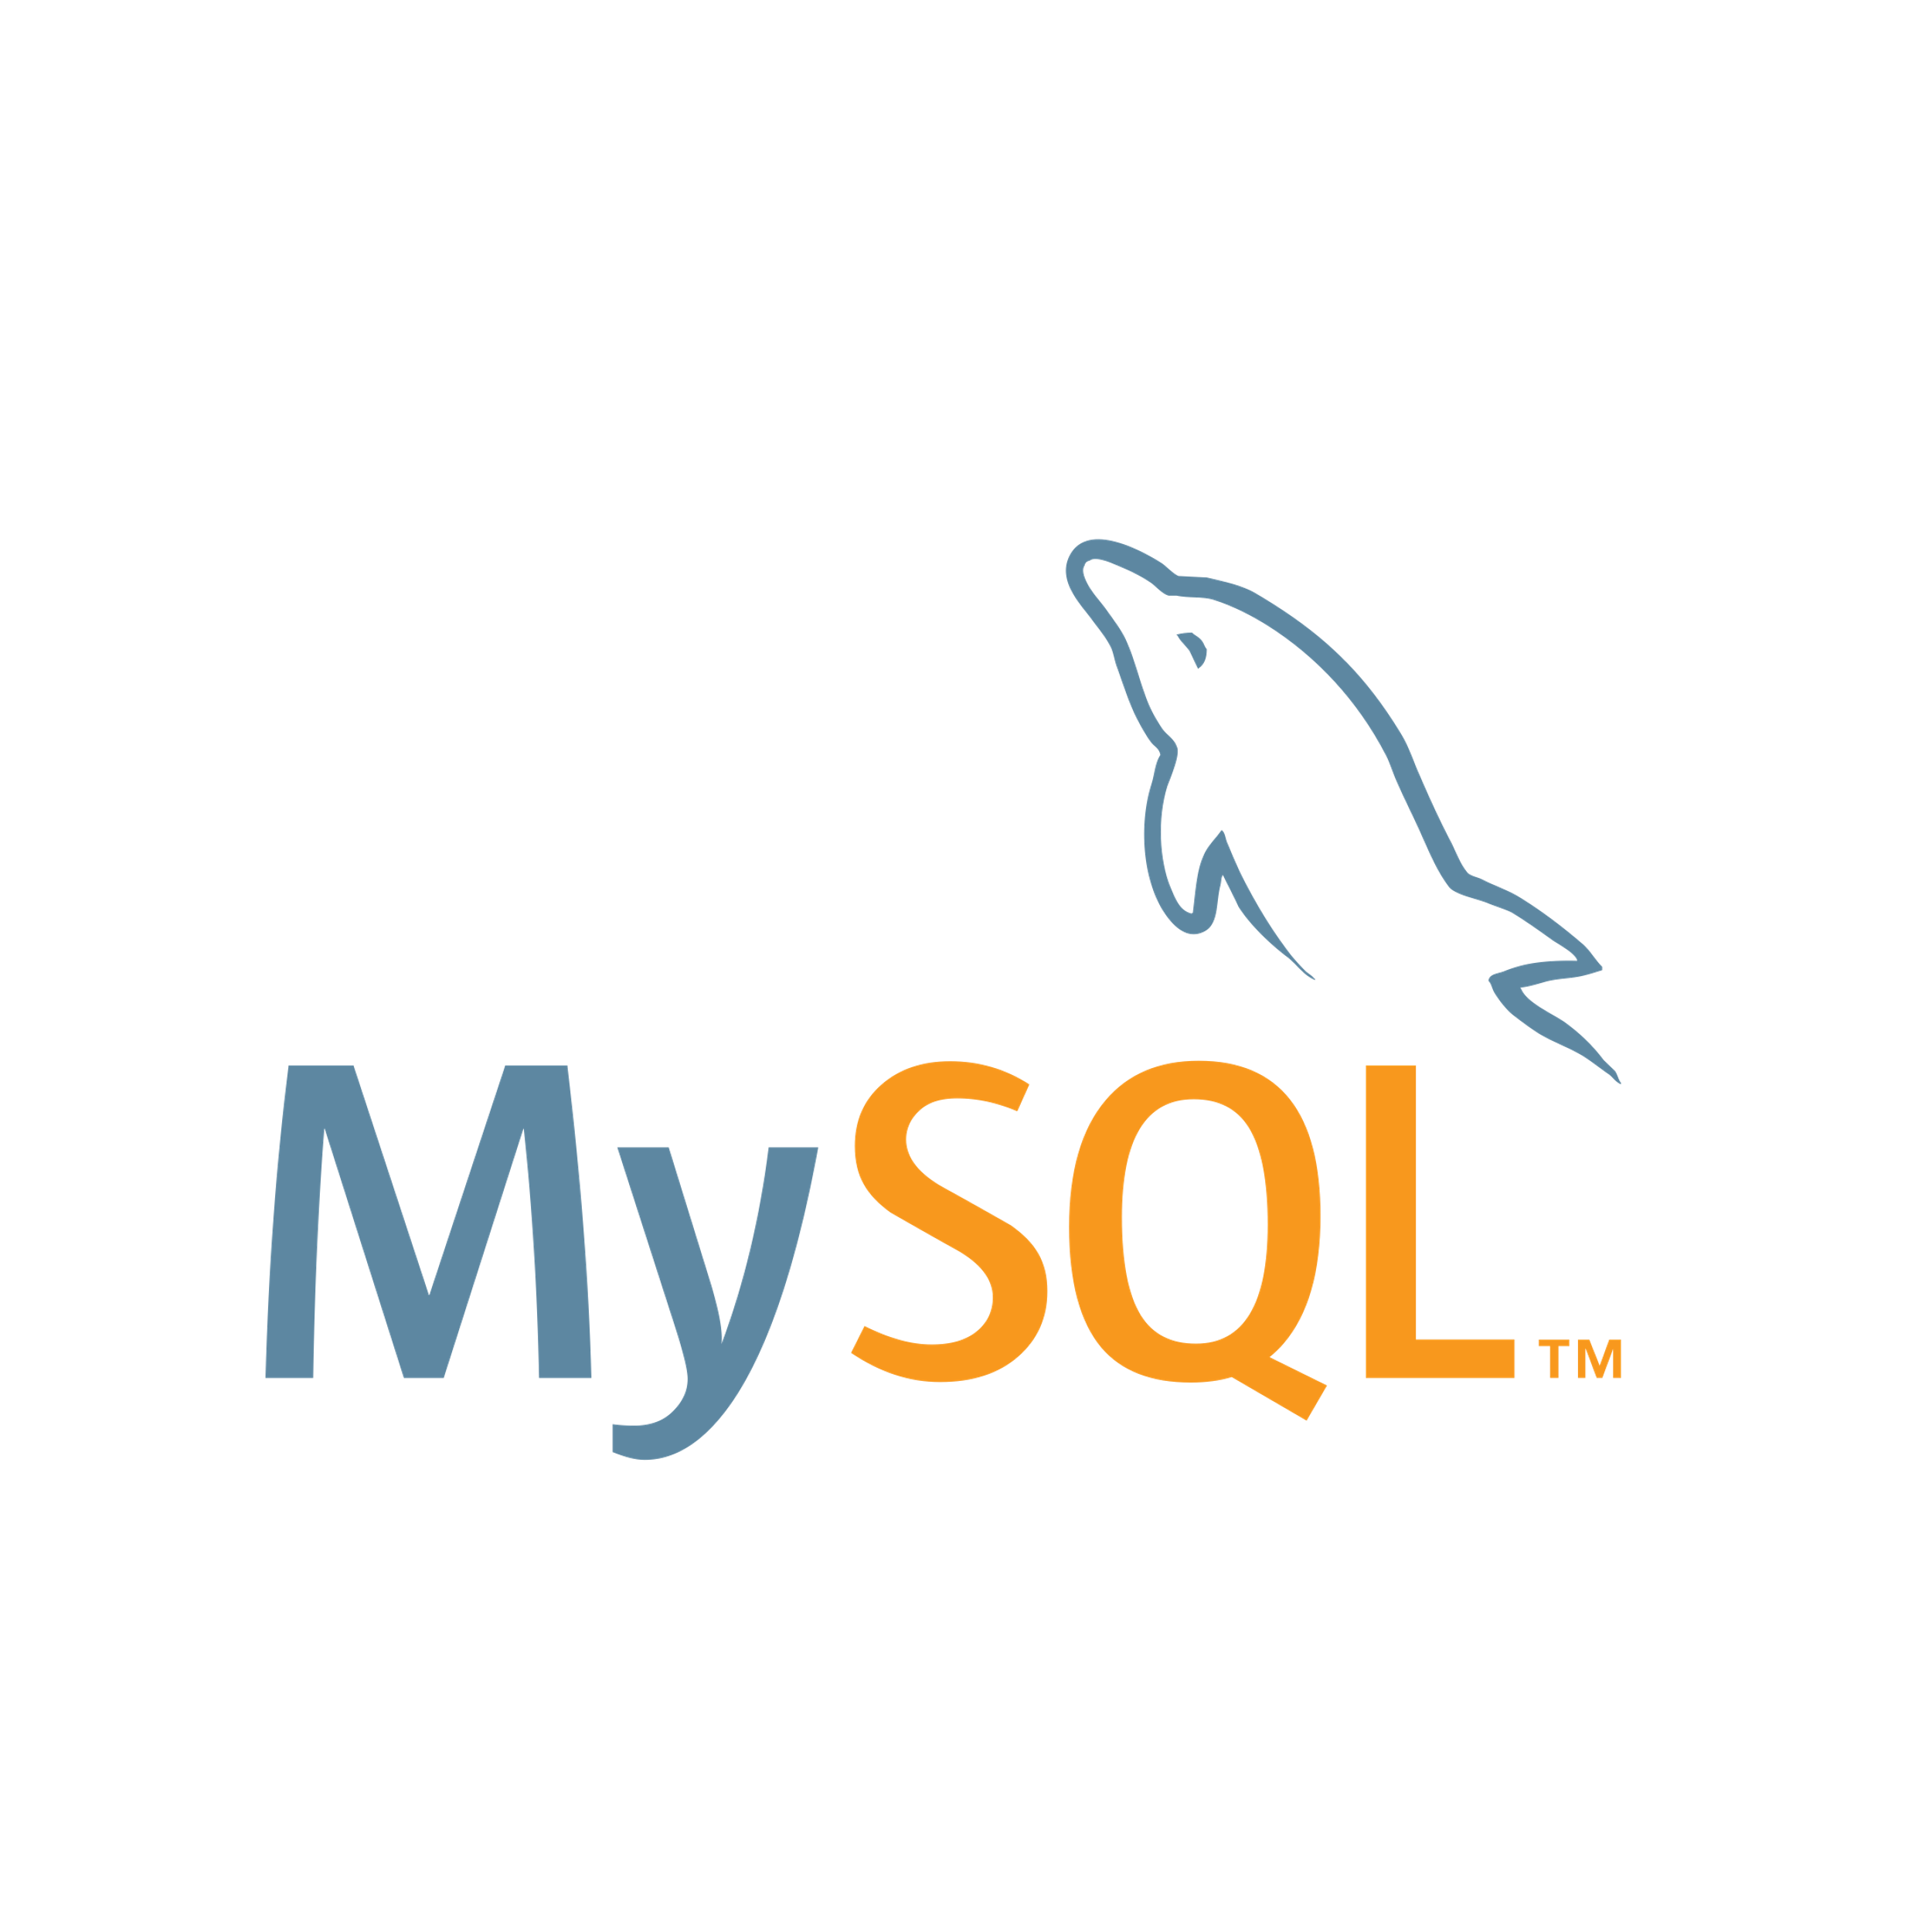
Data Integration using Tkinter
Prerequisites :
Install Python 3
Install necessary packages:
Pip install mysql-connector-python
Pip install tkinter
Or
Pip install * (this will automatically install all the packages required by the code file)
To Run: Python milestone3.py

Slide 17
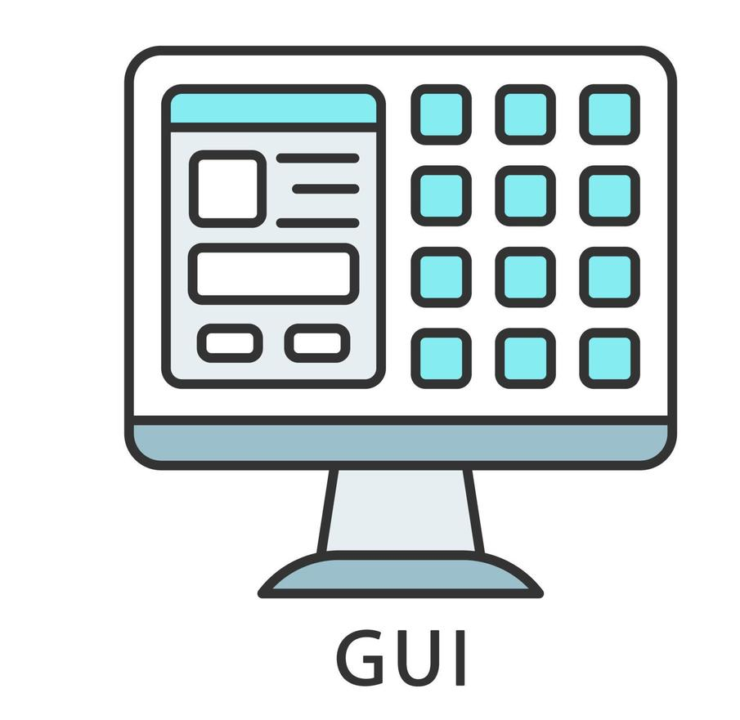
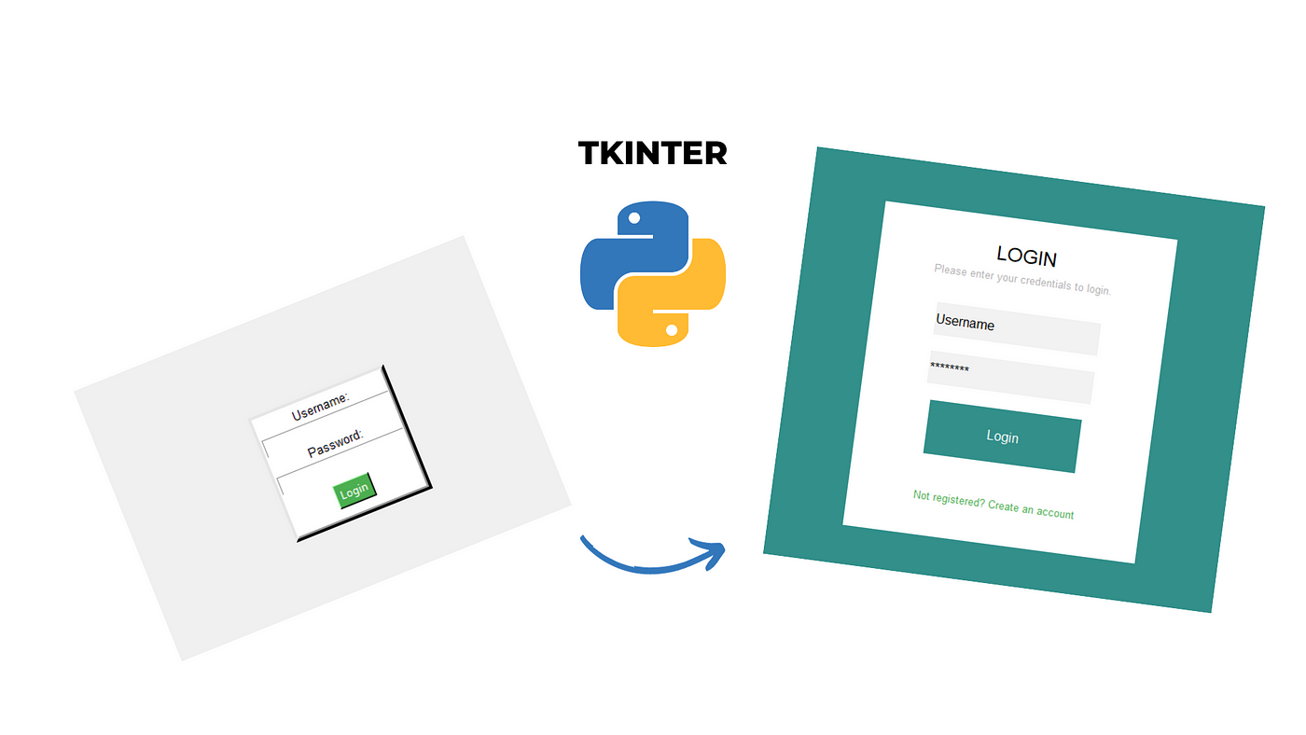
Overview of GUI
The Health Care Data Management System includes a graphical user interface (GUI) developed using Python and Tkinter.
The GUI allows users to interact with a healthcare database, execute queries, and view results efficiently.
The goal of this enhancement was to update the existing Python application to include a graphical user interface (GUI) using Tkinter, allowing users to easily interact with the healthcare database and visualize query outputs in a structured manner.

Slide 18
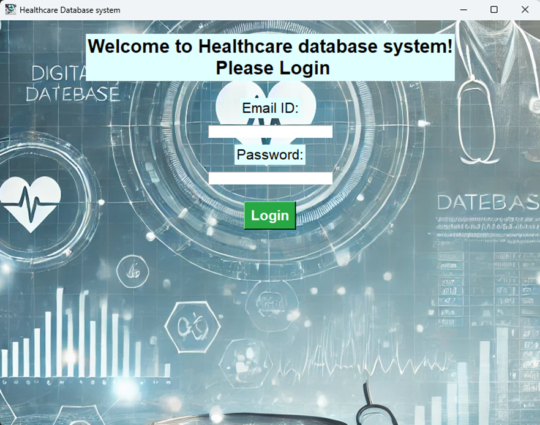
Login Window

Slide 19
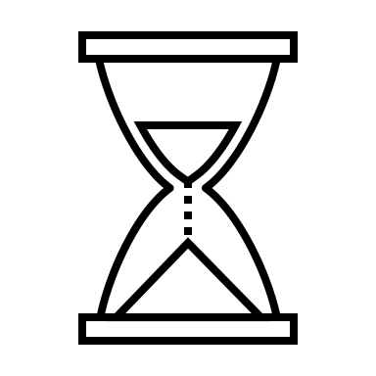

Demo For GUI Presentation

Slide 20
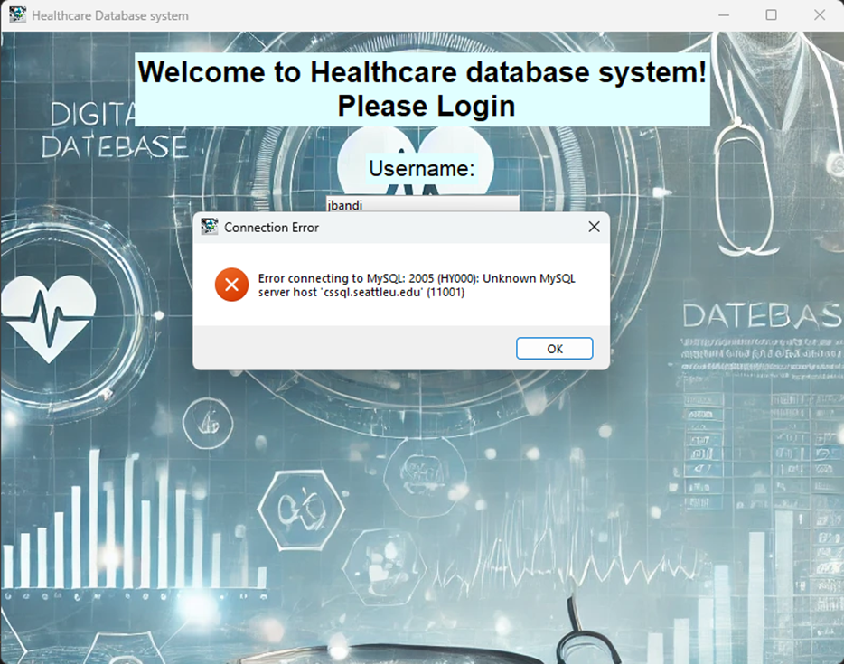
Database authentication using login window
A new Tkinter window is initialized for the login page, titled "Healthcare Database system."
The login window checks for the DB connection before logging into the main window.
If the connection is not established properly then it gives a connection error.
Similarly,it also authenticates the Users that are logging in.
Only specified users with Role ID 2, 3, 6(Doctor, Surgeon, Patient Care Technician)

Slide 21
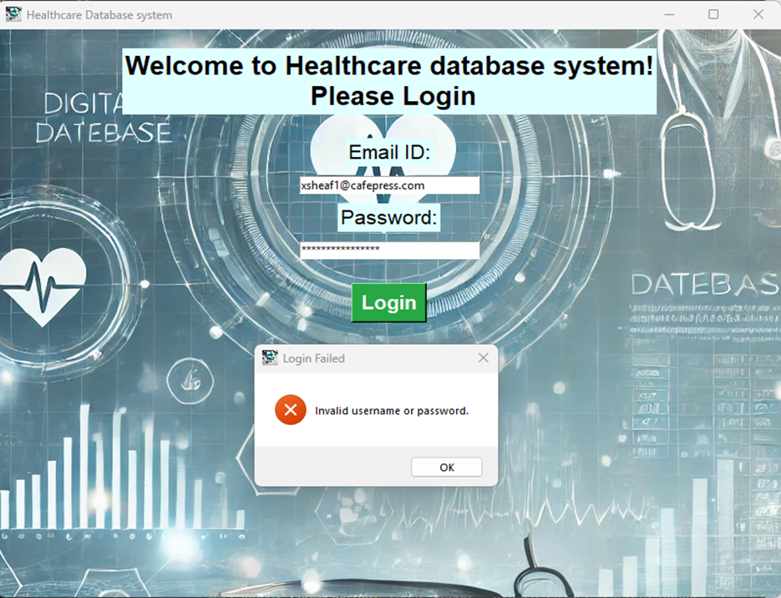
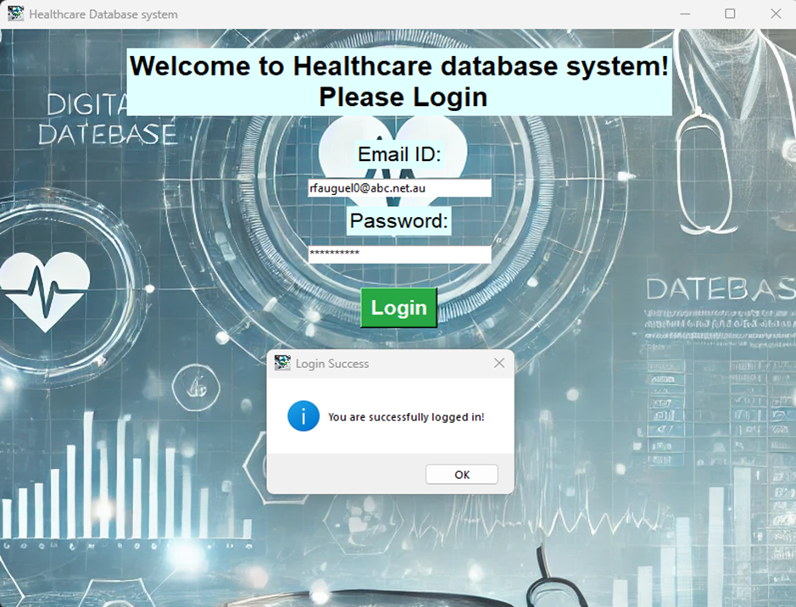
Login validation

Slide 22
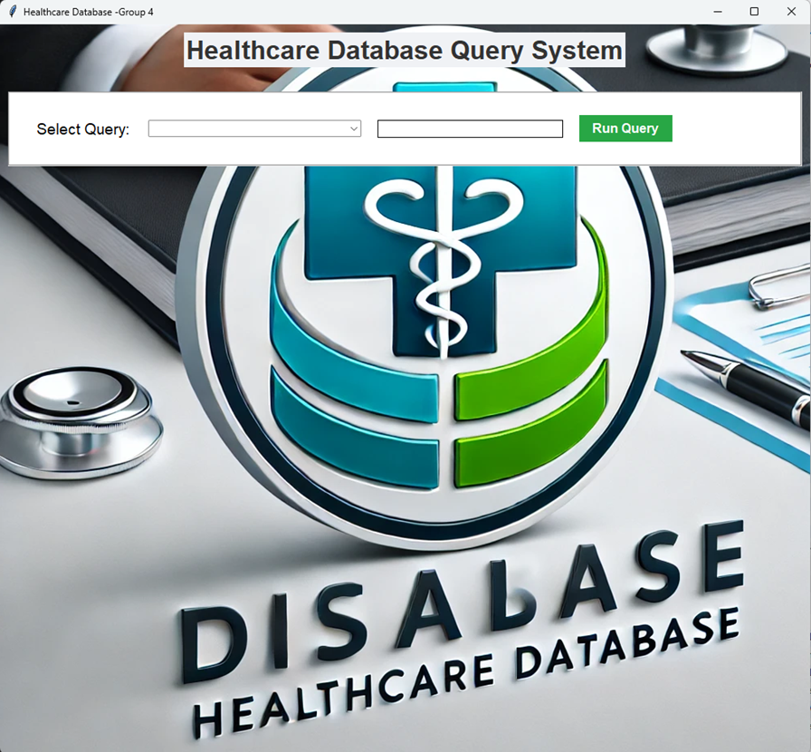
Healthcare Database system window
A new Tkinter window is initialized, titled "Healthcare Database system."
The Health care Database query system consists of Query Options box has a list of predefined queries to allow users to select from the available queries.
An entry field (userEntryParameter) is created for users to input parameters required for the selected query and a button to execute the selected query.

Slide 23
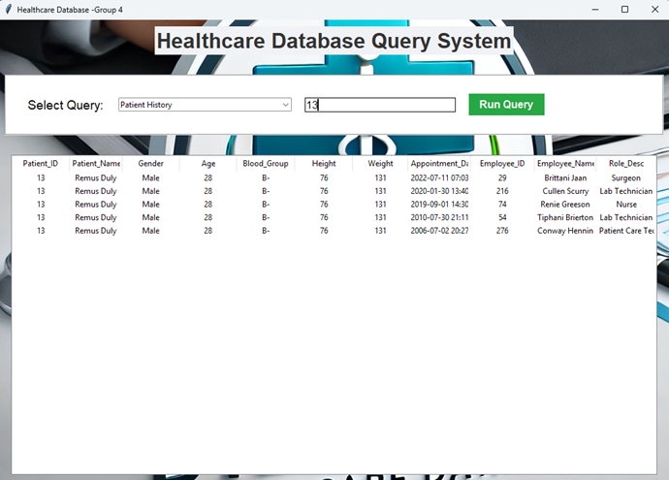
Patient history
This page allows users to view detailed patient history.
Users can select "Patient History" from the dropdown menu and enter a specific Patient ID in the input field. Upon clicking the "Run Query" button, the application retrieves and displays the patient's information.

Slide 24
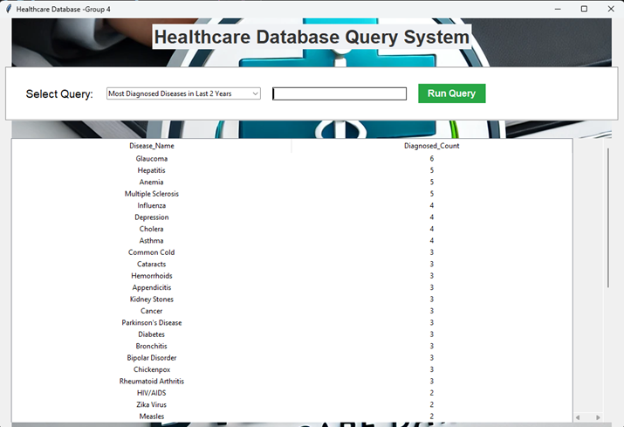
Most Diagnosed Diseases in last 2 years
On this page, users can explore the most diagnosed diseases over the last two years.
The dropdown menu allows selection of the query, and clicking "Run Query" retrieves the data: Disease Name, Diagnosed Count.

Slide 25
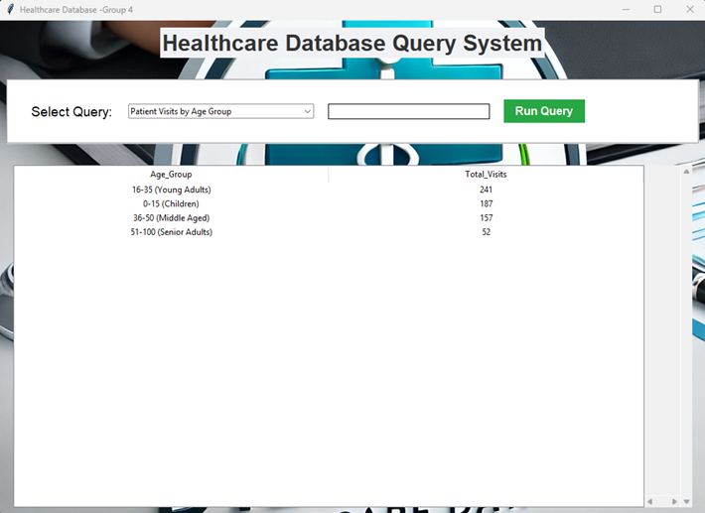
Patient visits by Age Group
This page enables users to analyze patient visits categorized by age groups. Users select the appropriate query and click "Run Query" .
Age Group: Categories such as "0-15 (Children)," "16-35 (Young Adults)," "36-50 (Middle Aged)," and “51-100 (Senior Adults).”
Total Visits: The number of visits recorded for each age group.

Slide 26
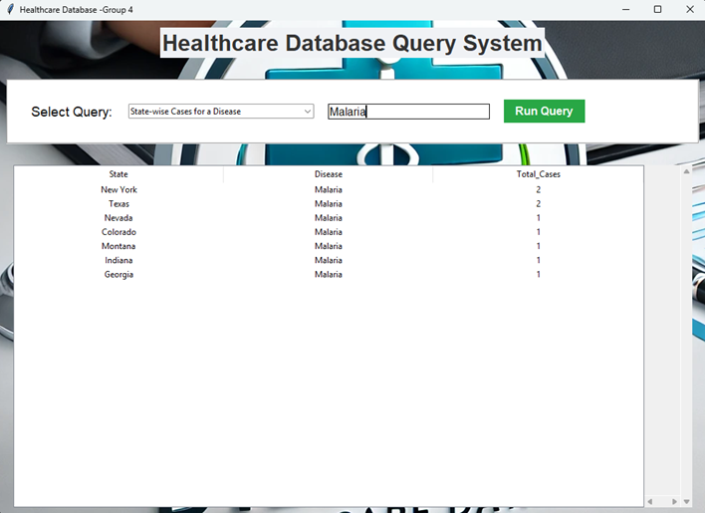
Statewise Cases for diseases
Users can examine cases of a specific disease across different states on this page. By selecting "State-wise Cases for a Disease" and entering a disease name (e.g., "Malaria"), users can run the query to obtain data.
State: Names of the states.
Disease: The disease in question.
Total Cases: The total number of reported cases for that disease in each state.

Slide 27
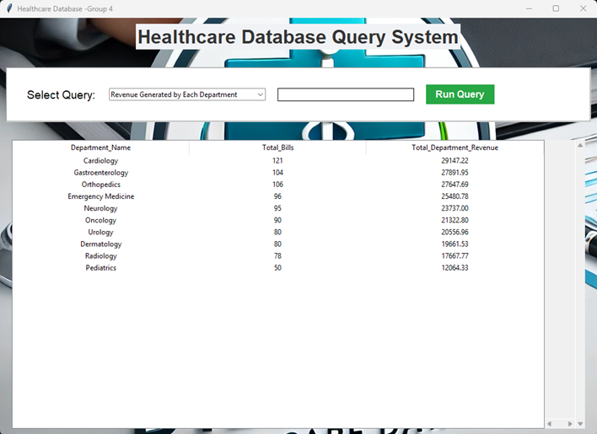
Revenue Generated by each department
This page allows users to view the financial performance of various departments within the healthcare facility. After selecting the query and clicking "Run Query," the following information is displayed.
Department Name: Names of the departments (e.g., Cardiology, Pediatrics).
Total Bills: Number of bills generated by each department.
Total Department Revenue: The total revenue generated by each department.

Slide 28
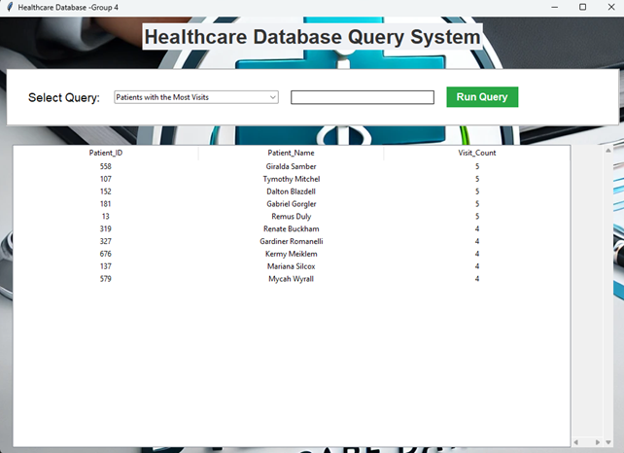
Patients with most visits
On this page, users can identify patients who frequently visit the healthcare facility. After selecting the relevant query and clicking "Run Query".
Patient ID: Unique identifier for each patient.
Patient Name: Full name of the patient.
Visit Count: The number of visits for each patient.

Slide 29
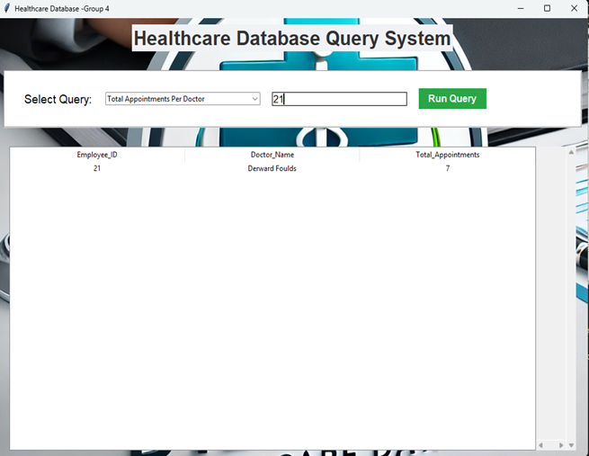
Total appointments per Doctor
This page allows users to analyze the appointment statistics for specific doctors. Users can enter an Employee ID and click "Run Query" to view:
Employee ID: The ID of the doctor.
Doctor Name: Full name of the doctor.
Total Appointments: The total number of appointments associated with that doctor.

Slide 30
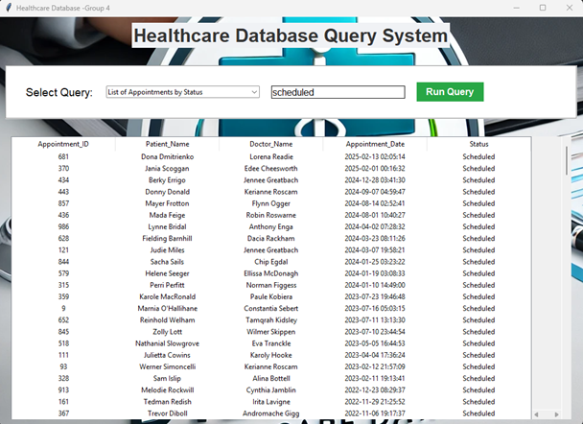
List of appointments by status
This page provides users with the ability to view and manage appointments based on their current status.
Users can select the "List of Appointments by Status" query from the dropdown menu and enter a specific appointment status (e.g., "Scheduled," "Completed," "Cancelled") in the input field.

Slide 31
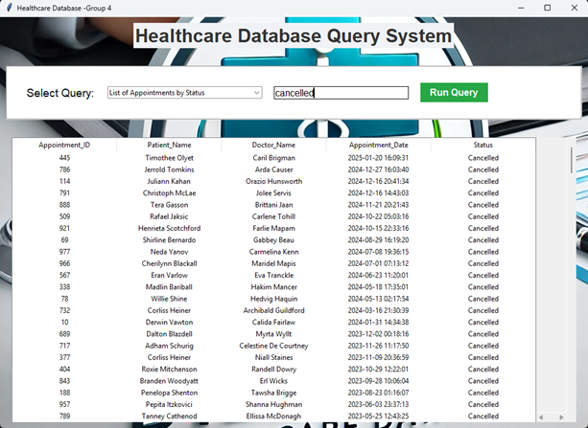
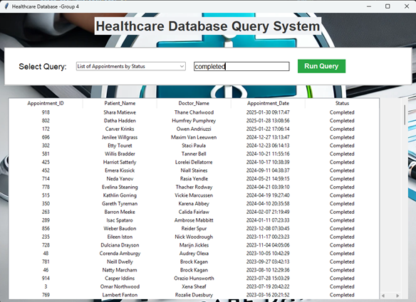
Appointments Cancelled
Appointments Completed

Slide 32
Data Visualization
To enhance our analysis, we visualized the healthcare data using Tableau.
Created the dashboard in Tableau which provides a comprehensive overview of hospital performance by tracking patient visits, disease trends, appointment efficiency, and resource utilization.
The visualizations align with the project goals of improving patient care, optimizing operations, and enhancing data-driven decision-making.

Slide 33
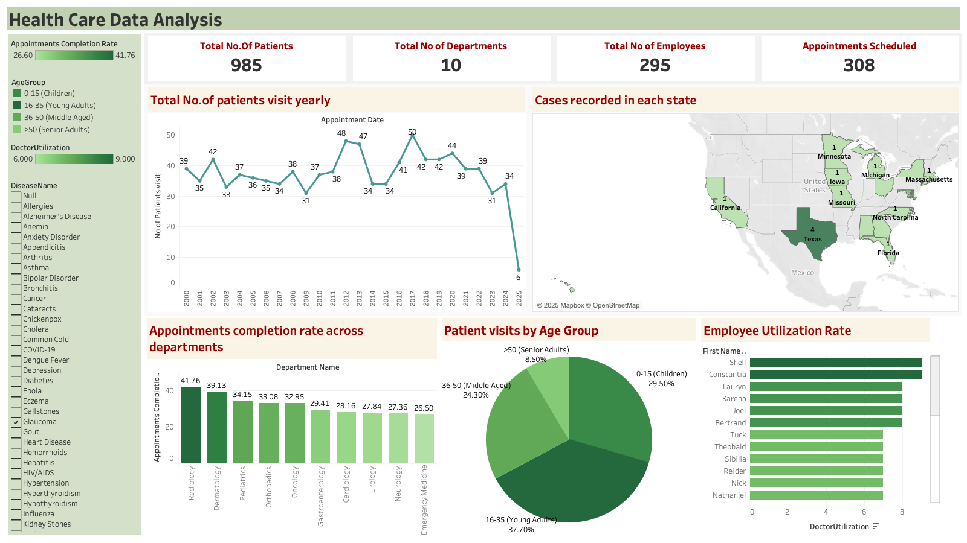

Slide 34
Conclusion
By leveraging data management techniques, the project ensures accurate, scalable, and real-time access to medical data, enabling better hospital workflows and patient care.
A relational database model provides structured storage, data consistency, and faster retrieval.
SQL-based queries and stored procedures automate critical hospital operations, deliver real-time insights on doctor performance, disease trends, etc.

Slide 35
Thank You!

